Slide 1



Collection of Games Application
Eric Mott

Slide 2
Motivation
My personal interest in games and trying to develop them
Creating a “one stop shop” for games
Creating a well made application that I enjoy, as well as something I can use in my professional portfolio

Slide 3
Proposal
Develop an application that has multiple different games to chose from where the user can pick which game(s) they would like to play. With social aspects and leaderboards to compete with friends.

Slide 4
App Features
Allow users to pick from 5-8 different games they enjoy
Allow users to keep track of high scores in each game
Stats page that shows how long they have played each game, the last time they played the game and keep track of which game they frequent most
The ability to compare your stats with friends and challenge them to beat your high scores

Slide 5
Phone Requirements
Android 5.0 (82.3% of users are 5.0 or above)
Internet access (If the user wants to compare stats)
Google account to link the users stats
Storage (exact amount TBA)

Slide 6
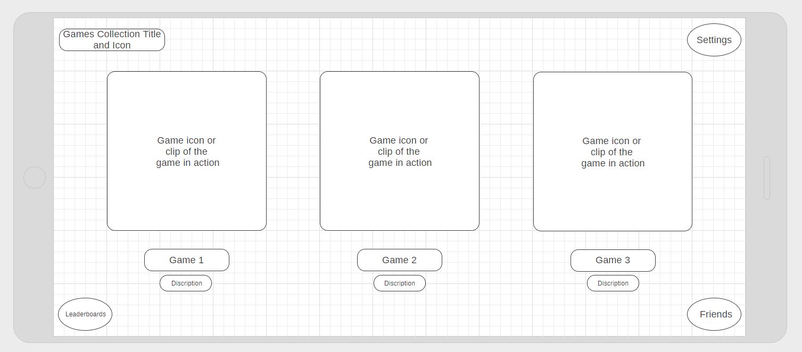
Mockups

Slide 7
Project Timeline
Week 1: First game/UI
Week 2: Second game/UI
Week 3: Third game/UI
Week 4: Nail down UI/Leaderboards/Social Aspect
Week 5: Fourth game/Leaderboards/Social Aspect/UI
Week 6: Final presentation/Debug tweak if needed
Week 7: Present the project

Slide 8
Anticipated Deliverables
Android app with a suite of games
Some game ideas include:
Tetris
Snake
Platform jumper (think Doodle Jump)
Flappy bird
Pipe Dream
Snake
Endless runner
Tank battle
Minesweeper
Board games(Chess, Checkers, Etc.)
Memory puzzle
Others

